Slide 1
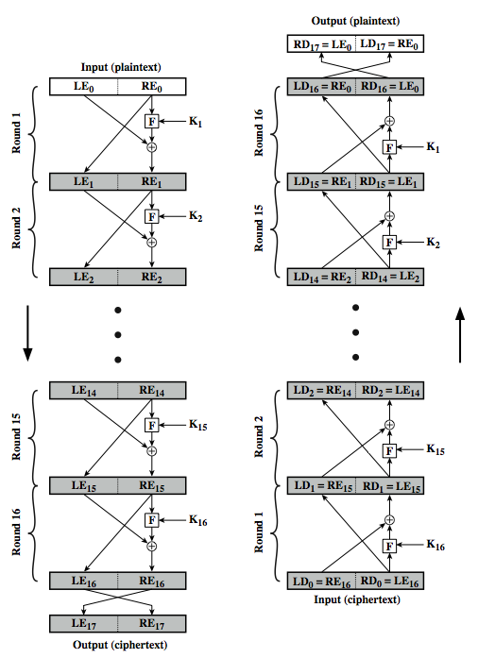
Feistel Cipher Structure
Notes:
Stallings Figure 3.3 illustrates the classical feistel cipher structure, with data split in 2 halves, processed through a number of rounds which perform a substitution on left half using output of round function on right half & key, and a permutation which swaps halves, as listed previously. The LHS side of this figure shows the flow during encryption, the RHS in decryption.
The inputs to the encryption algorithm are a plaintext block of length 2w bits and a key K. The plaintext block is divided into two halves, L₀ and R₀. The two halves of the data pass through n rounds of processing and then combine to produce the ciphertext block. Each round i has as inputs L_{i–1} and R_{i–1}, derived from the previous round, as well as a subkey K_{i}, derived from the overall K. In general, the subkeys K are different from K and from each other.
The process of decryption with a Feistel cipher is essentially the same as the encryption process. The rule is as follows: Use the ciphertext as input to the algorithm, but use the subkeys K_{i} in reverse order. That is, use K_{n} in the first round, K_{n–1} in the second round, and so on until K₁ is used in the last round. This is a nice feature because it means we need not implement two different algorithms, one for encryption and one for decryption. See discussion in text for why using the same algorithm with a reversed key order produces the correct result, noting that at every round, the intermediate value of the decryption process is equal to the corresponding value of the encryption process with the two halves of the value swapped.

Slide 2

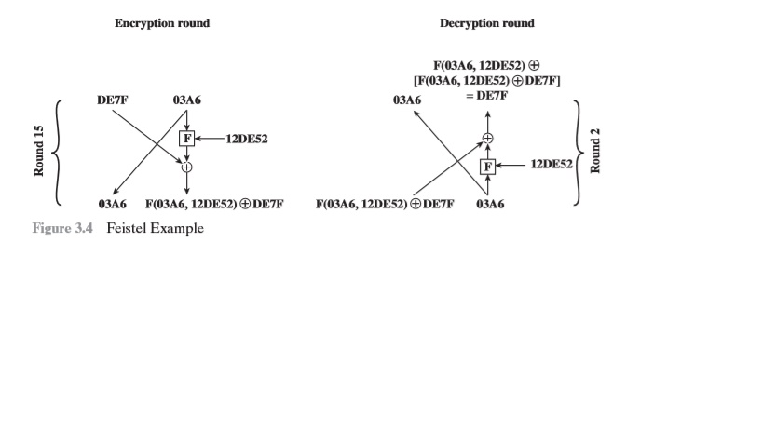
For Example

Slide 3
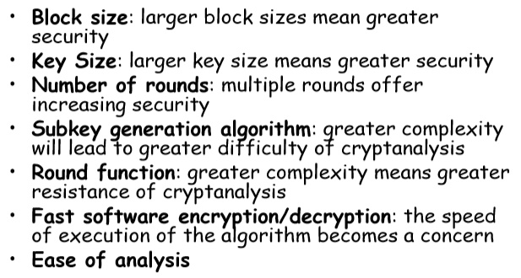
Feistel Cipher Design Elements

Slide 4
DATA ENCRYPTION STANDARD (DES)

Slide 5
Outline
History
Encryption
Key Generation
Decryption
Strength of DES
Block Cipher Design Principles

Slide 6
Data Encryption Standard (DES)
most widely used block cipher in world
adopted in 1977 by NBS (now NIST)
  as FIPS PUB 46
encrypts 64-bit data using 56-bit key
has widespread use
has been considerable controversy over its security
Notes:
The most widely used private key block cipher, is the Data Encryption Standard (DES). It was adopted in 1977 by the National Bureau of Standards as Federal Information Processing Standard 46 (FIPS PUB 46). DES encrypts data in 64-bit blocks using a 56-bit key. The DES enjoys widespread use. It has also been the subject of much controversy its security.

Slide 7
History
In 1971, IBM developed an algorithm, named LUCIFER which operates on a block of 64 bits, using a 128-bit key
Walter Tuchman, an IBM researcher, refined LUCIFER and reduced the key size to 56-bit, to fit on a chip.

Slide 8
History
In 1977, the results of Tuchman’s project of IBM was adopted as the Data Encryption Standard by NSA (NIST).

Slide 9
A Simplified DES-Type Algorithm
Suppose that a message has 12 bits and is written as L₀R₀ , where L₀ consists of the first 6 bits and R₀ consists of the last 6 bits.
The key K has 9 bits. The ith round of the algorithm transforms an input L_{i-1}R_{i-1} to the output L_{i}R_{i} using an 8-bit key K_{i} derived from K.
The main part of the encryption process is a function f(R_{i-1},K_{i}) that takes a 6-bit input

Slide 10
R_{i-1} and an 8-bit input K_{i} and produces a 6-bit
output which will be described later.
The output of the ith round is defined as:
L_{i} = R_{i-1} and R_{i} = L_{i-1} XOR f(R_{i-1},K_{i})
The decryption is the reverse of encryption.
[L_{n}] [R_{n} XOR f(L_{n}, K_{n})] = … =[R_{n-1}] [L_{n-1}]

Slide 11
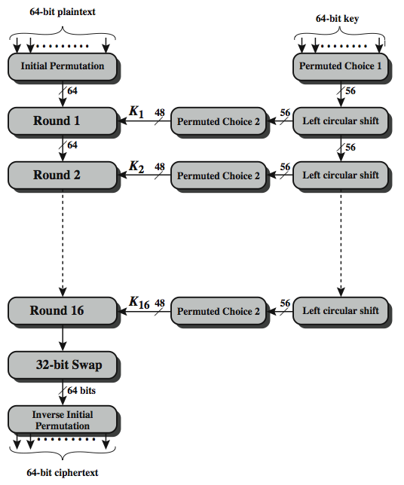
DES Encryption Overview
Notes:
The overall scheme for DES encryption is illustrated in Stallings Figure 3.4, which takes as input 64-bits of data and of key.
The left side shows the basic process for enciphering a 64-bit data block which consists of:
- an initial permutation (IP) which shuffles the 64-bit input block
- 16 rounds of a complex key dependent round function involving substitutions & permutations
- a final permutation, being the inverse of IP
The right side shows the handling of the 56-bit key and consists of:
- an initial permutation of the key (PC1) which selects 56-bits out of the 64-bits input, in two 28-bit halves
- 16 stages to generate the 48-bit subkeys using a left circular shift and a permutation of the two 28-bit halves

Slide 12
Encryption (cont.)
64-bit plaintext (X)
Initial Permutation (IP)
64-bit key (K)
Key _{i}
Round _{(i)}
Key Generation (KeyGen)
32-bit Switch (SW)
Inversion of Initial Permutation (IP⁻¹)
64-bit ciphertext (Y)

Slide 13
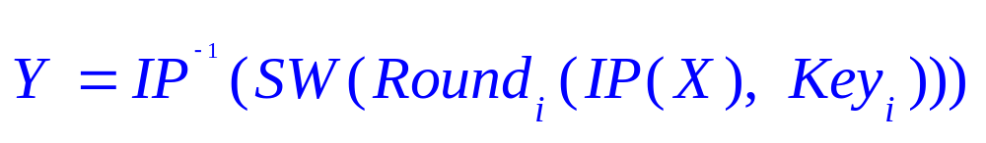
Encryption (cont.)
Plaintext: X
Initial Permutation: IP( )
Round_{i}: 1≤ i ≤ 16
32-bit switch: SW( )
Inverse IP: IP⁻¹( )
Ciphertext: Y

Slide 14
Encryption (IP, IP⁻¹)
IP
IP⁻¹
Bit | 0 | 1 | 2 | 3 | 4 | 5 | 6 | 7
1 | 58 | 50 | 42 | 34 | 26 | 18 | 10 | 2
9 | 60 | 52 | 44 | 36 | 28 | 20 | 12 | 4
17 | 62 | 54 | 46 | 38 | 30 | 22 | 14 | 6
25 | 64 | 56 | 48 | 40 | 32 | 24 | 16 | 8
33 | 57 | 49 | 41 | 33 | 25 | 17 | 9 | 1
41 | 59 | 51 | 43 | 35 | 27 | 19 | 11 | 3
49 | 61 | 53 | 45 | 37 | 29 | 21 | 13 | 5
57 | 63 | 55 | 47 | 39 | 31 | 23 | 15 | 7
Bit | 0 | 1 | 2 | 3 | 4 | 5 | 6 | 7
1 | 40 | 8 | 48 | 16 | 56 | 24 | 64 | 32
9 | 39 | 7 | 47 | 15 | 55 | 23 | 63 | 31
17 | 38 | 6 | 46 | 14 | 54 | 22 | 62 | 30
25 | 37 | 5 | 45 | 13 | 53 | 21 | 61 | 29
33 | 36 | 4 | 44 | 12 | 52 | 20 | 60 | 28
41 | 35 | 3 | 43 | 11 | 51 | 19 | 59 | 27
49 | 34 | 2 | 42 | 10 | 50 | 18 | 58 | 26
57 | 33 | 1 | 41 | 9 | 49 | 17 | 57 | 25
Note: IP(IP⁻¹) = IP⁻¹(IP) = I

Slide 15
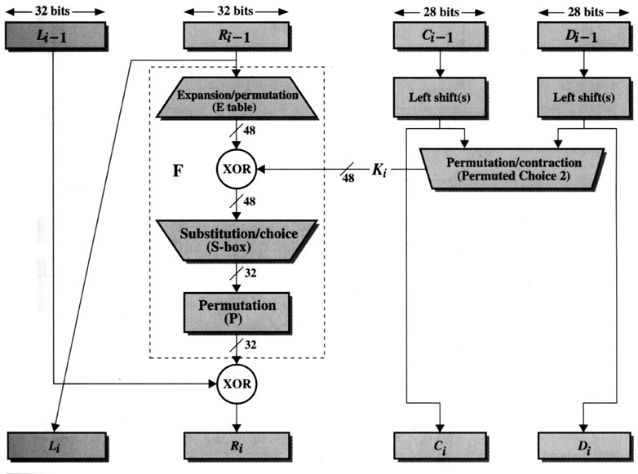
Encryption (Round)
(Key Generation)
[1]

Slide 16
Encryption (Round) (cont.)
L_{i-1}
R_{i-1}
Expansion/permutation (E_table)
XOR
K_{i}
F
Substitution/choice (S-box)
Permutation (P)
XOR
L_{i}
R_{i}

Slide 17
Key Generation
(Encryption)
[1]

Slide 18
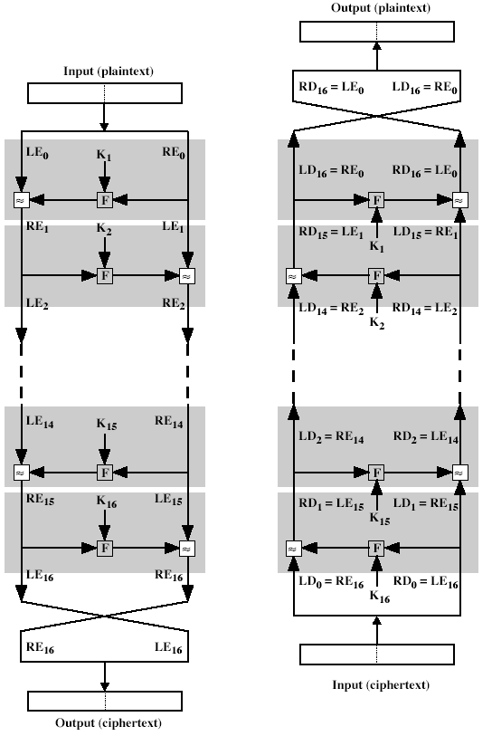
Decryption
The same algorithm as encryption.
Reversed the order of key (Key₁₆, Key₁₅, … Key₁).
For example:
  IP undoes IP⁻¹ step of encryption.
  1st round with SK16 undoes 16th encrypt round.
[1]

Slide 19
Strength of DES
Use of 56 bit keys
(56-bit keys have 2⁵⁶ = 7.2 x 10¹⁶ values)
  Brute force search looks hard.
  A machine performing one DES encryption per microsecond would take more than a thousand year to break the cipher.
  So a 128-bit key is guaranteed to result in an algorithm that is unbreakable by brute force or EFF98. • 128-bit key would take over 10¹⁸years to break the code using the EFF cracker.
Nature of the DES Algorithm (8 S-Box)

Slide 20
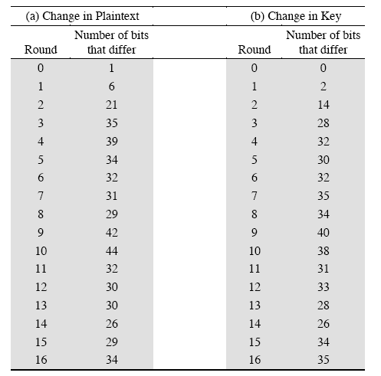
Strength of DES (cont.)
Avalanche effect in DES
  If a small change in either the plaintext or the key, the ciphertext should change markedly.
DES exhibits a strong avalanche effect.

Slide 21
References
[1] William Stallings, Cryptography and
Network Security, 1999.
https://www.youtube.com/watch?v=SaZGjQBItBc

